Slide 1
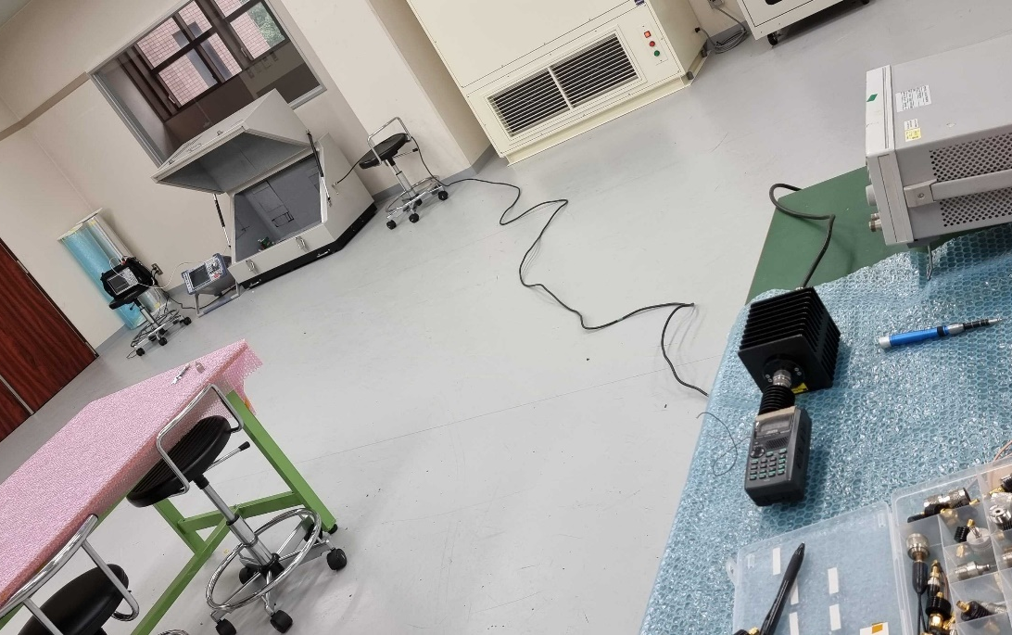
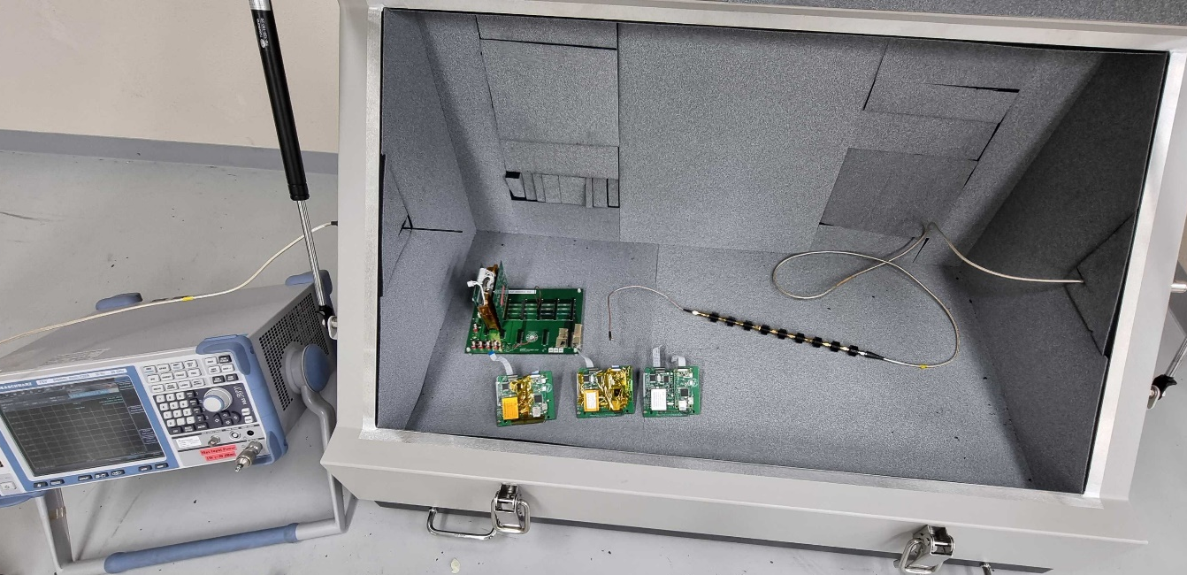
VHF Uplink Sensitivity Measurement
(Shield Box)

Slide 2
Cable Test Results
Ptx (dBm) | Total Attn(dB) | Expected power at Rx(dBm) | Uplink Success (Board A) | Uplink Success (Board B) | Uplink Success (Board C)
37 | 152.4 | -115.4 | 4/4 | 4/4 | 4/4
37 | 154.4 | -117.4 | 3/4 | 4/4 | 4/4
37 | 155.4 | -118.4 | 0/4 | 3/4 | 2/4
37 | 156.4 | -119.4 | 0/4 | 0/4 | 0/4
37 | 157.4 | -120.4 | 0/4 | 0/4 | 0/4

Slide 3
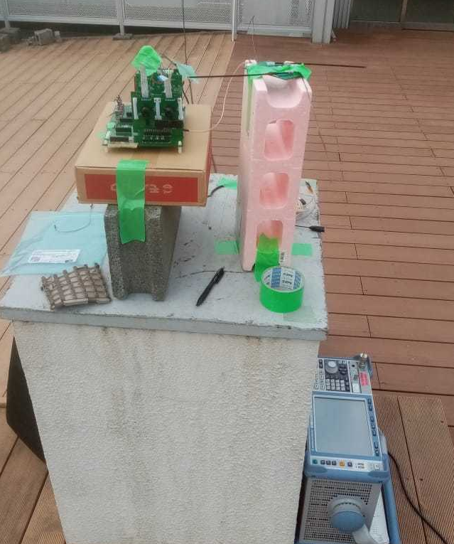
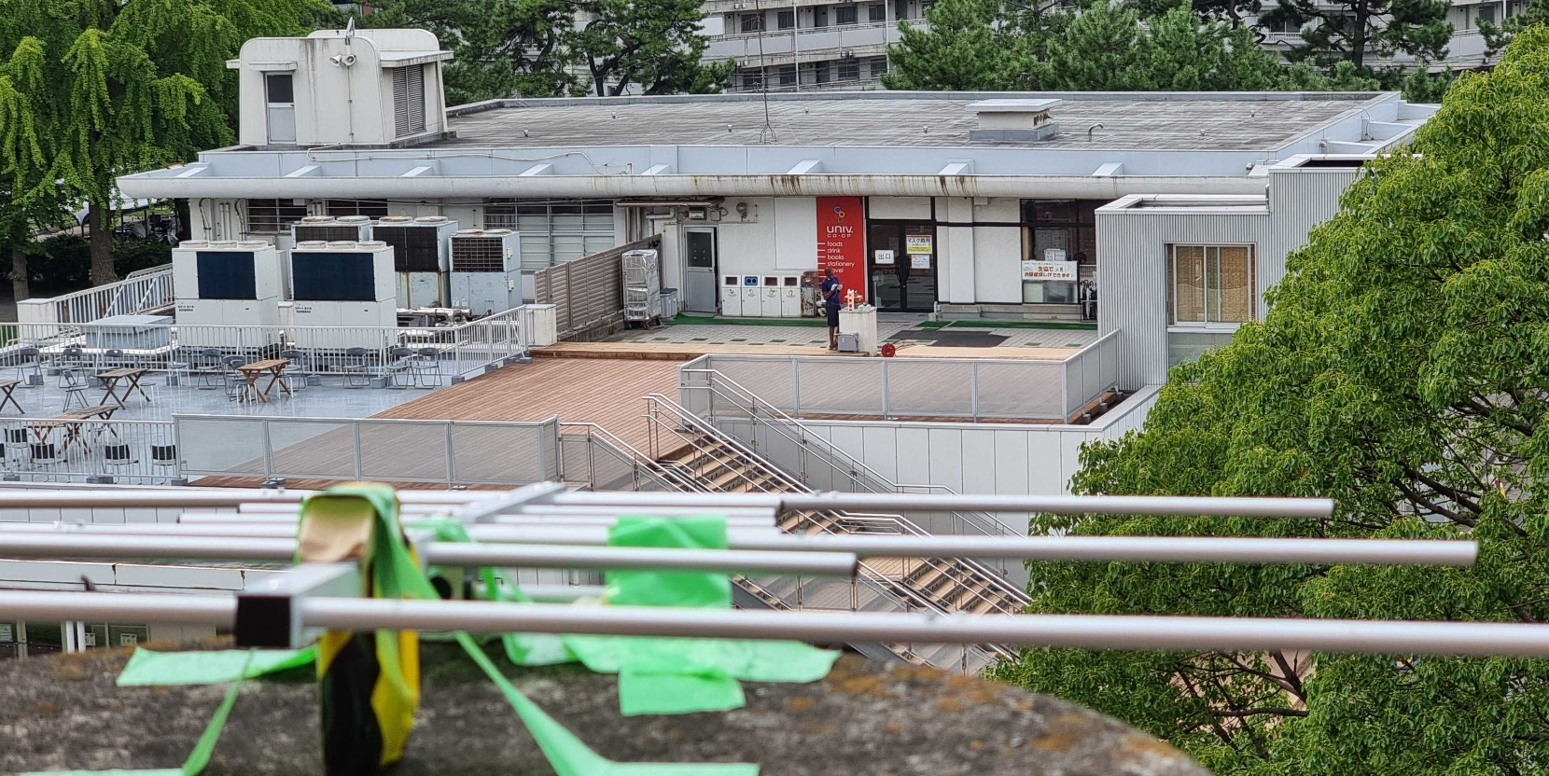
VHF Uplink Sensitivity Measurement
(Open Air)
Satellite side
GS side (VHF 9.5dBi Antenna)

Slide 4
Cable Test Results
Ptx (dBm) | Total Attn(dB) | Expected power at Rx(dBm) | Uplink Success (Trial 1) | Uplink Success (Trial 2) | Uplink Success (Trial 3)
17 | 110.5 | -93.5 | 4/4 | 4/4 | 4/4
17 | 111.5 | -94.5 | 2/4 | 4/4 | 4/4
17 | 112.5 | -95.5 | xx | 4/4 | 4/4
17 | 114.5 | -97.5 | xx | 4/4 | 4/4
17 | 117.5 | -100.5 | xx | 4/4 | 4/4
17 | 118.5 | -101.5 | xx | 4/4 | 4/4
17 | 121.5 | -104.5 | xx | 4/4 | 3/4
17 | 122.5 | -105.5 | xx | 4/4 | xx
17 | 123.5 | -106.5 | xx | 4/4 | xx
17 | 124.5 | -107.5 | xx | 4/4 | xx
17 | 125.5 | -108.5 | xx | 4/4 | xx

Slide 5
Observations during the test
Antenna Calibration & Consistence was verified to be OK.
During all Successful uplinks, at the highest attenuations, ACK was fully Decoded (Strange)
Beacons were fully decoded on the Radio side even with no uplink success (Strange)
Deductions
There is RF leakage for Downlink
We also cannot rely on Uplink sensitivity measurement
We suggest to re-do Anechoic Chamber test (No leakage)

Slide 6
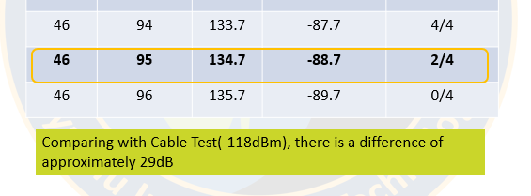
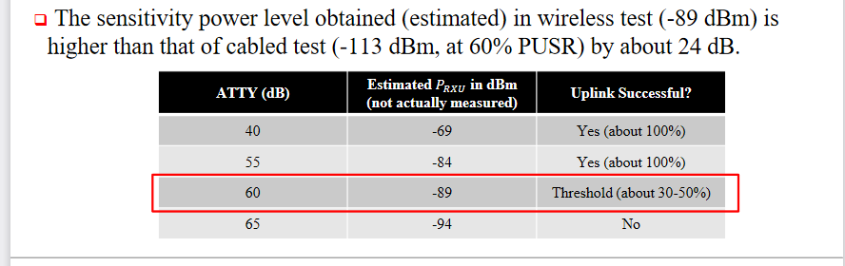
BIRDS-5 Anechoic sensitivity Report
BIRDS-2 wireless sensitivity Report

